Slide 1

Fast Transform
Khoi Phan
Packaged Creator: MikaelSlevinsky, dlfivefifty
, utianyi889

Slide 2
What does Fast Transform do
Fast transform apply some of the concept that we learn in class in order to make the computer run in polynomial time. They apply the concept in Linear Algebra to solve problem such as RoofFinding and Regression. It is apply to the real world computer with less of limit and more optimizing

Slide 3
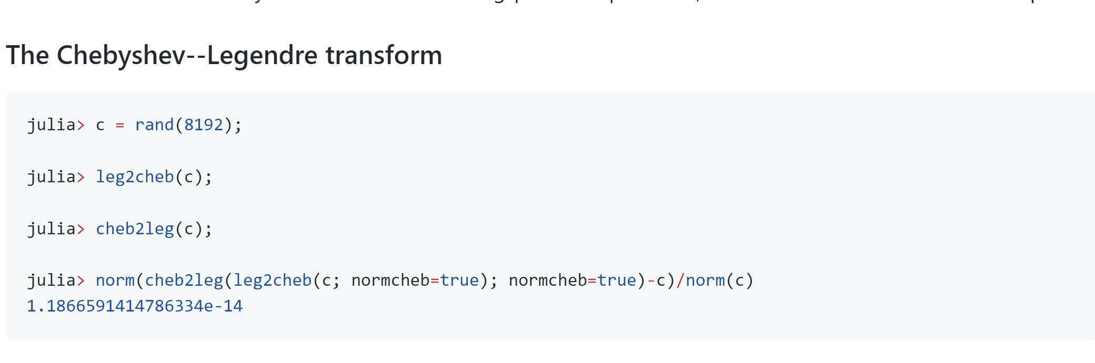
Some Example
So there is some good example about the Fast transform that we can see in the write up
The Chebyshev—Legendre transform which is used in the dynamite and theoretical mechanic in physic which help us save more time in the calculation in the Legendre transform in the formula and perform it better than manual

Slide 4
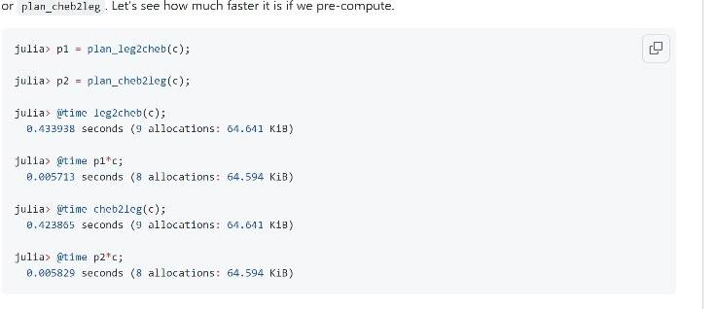
Other example:
This the runtime of the function above which is the function that we pre-compute which we can see that it is faster than we do it manually any run it .

Slide 5
The purpose of this package
It is to help us perform and optimizing the function such as Fast transform, spherical harmonic transform, Nonuniform fast fourier, Padua transform and many other.
It help us as a programmer or a engineer can easy using this kind of difficulty equal and time consuming to either to code it out or write it done by paper. But if we can just use it like an array or a function call then it can be so much faster and time efficiency

Slide 6
How to run the packages
First we need to download Julia to run in our local machine because jupyterhub don’t have engouh
Open Julia
Use “add FastTransform” to down to add the packages
Remember to clone the git FastTransforms
U can use include(“whatever test u want”) to run it

Slide 7
Different test case
We and our team are trying for different test case in the fast form in order to see are there any function which will make the test break at any point or show out if there is any error that need to be fix in the coding.

Slide 8
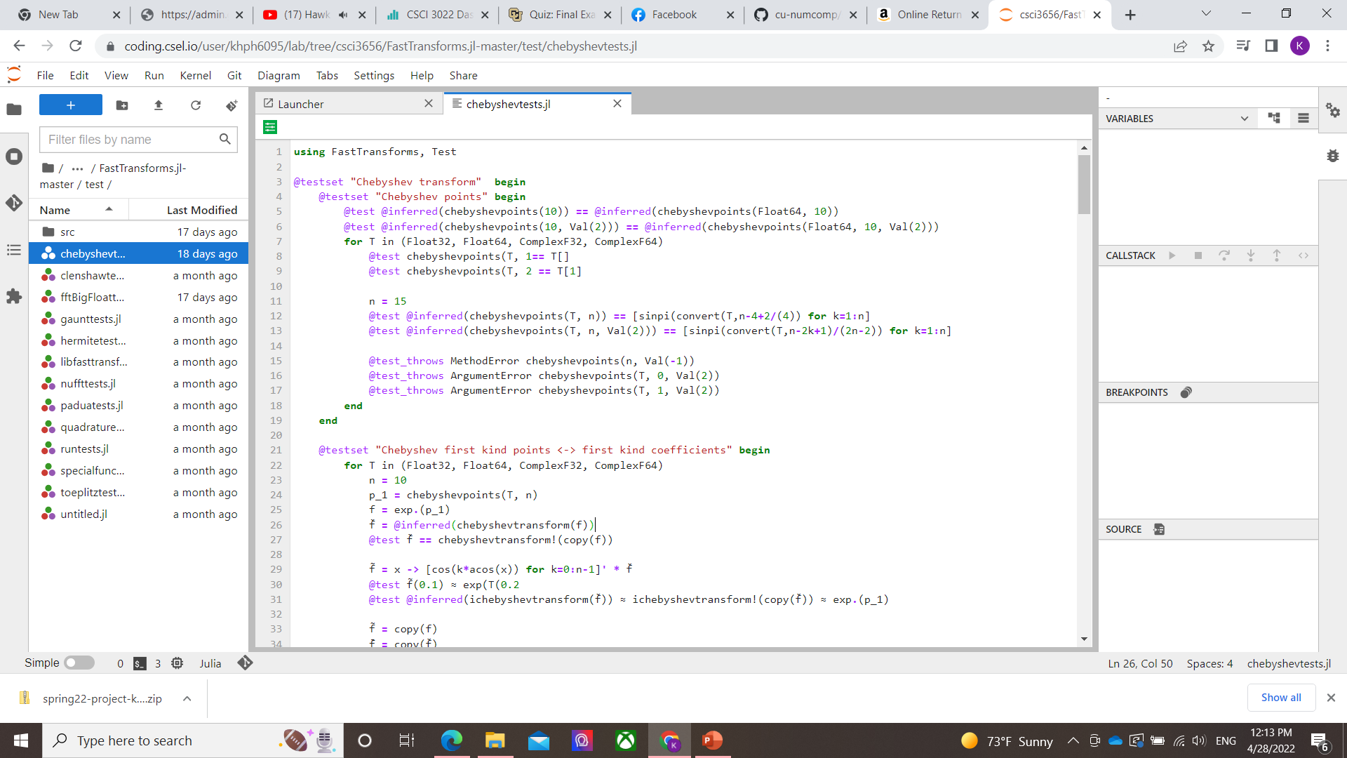
Different value trial
For every function in the fast transform I have tried it different in order to see what is the Fast Transform limit for it but the code and it is very tight writing and structure in a good form that cannot

Slide 9
Trying to break the code
For the coding that base on the theory will have be strictly in the coding so that it can perform a good structure with a fast running. I have attempt to break the code with the uniform hasing and other thing in order to see if it structure correctly

Slide 10
Why do we need a something like this and will it help us in the future
Yes so what the jobs of the computer is to lower our jobs special involve in those complex theory and algorithms so that we can use the answer for more thing in the future

